Slide 1
Brereton Spurs and Chetwynd Coppice
John Kewley (AKA “JK”)
with some useful additions from Peter Bray (PTB)

Slide 2
Introduction
What to expect, reduce surprises, less chance of gotchas
Shape of the terrain
Map related stuff
Tactics to employ

Slide 3
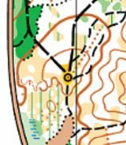
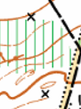
Map spec
1:10,000 with 5m contours (same as e.g. Lyme Park)
Special symbols on previous map:
A black circle with central dot (526 Cairn) for a triangulation pillar (trig point)
A black X (531 Prominent man-made feature – x) for a hide

Slide 4
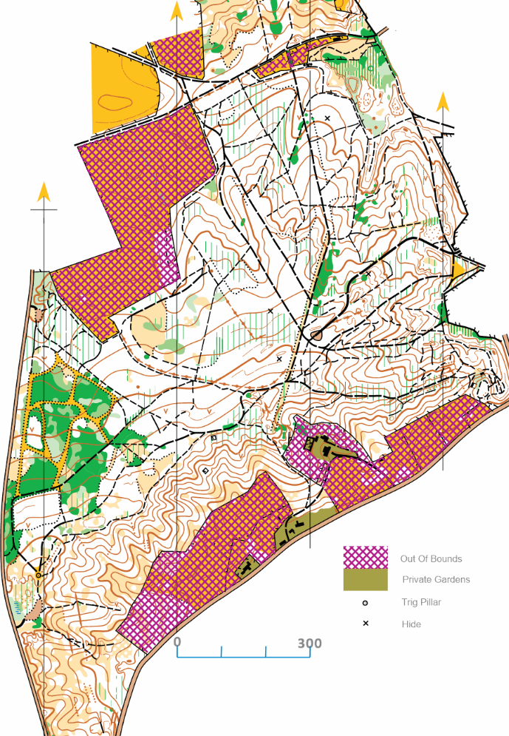
A quick look at the map
B
D
Very few contour tags are used
Few point features
What is the general shape of area?
What is up and what is down?
How flat/steep is it?
Many paths/tracks?
Possibility of parallel errors?
C
A

Slide 5
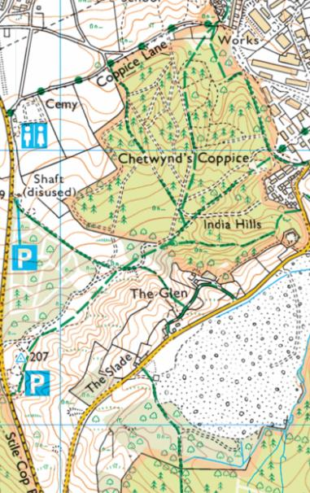
OS 1:25,000 map

Slide 6
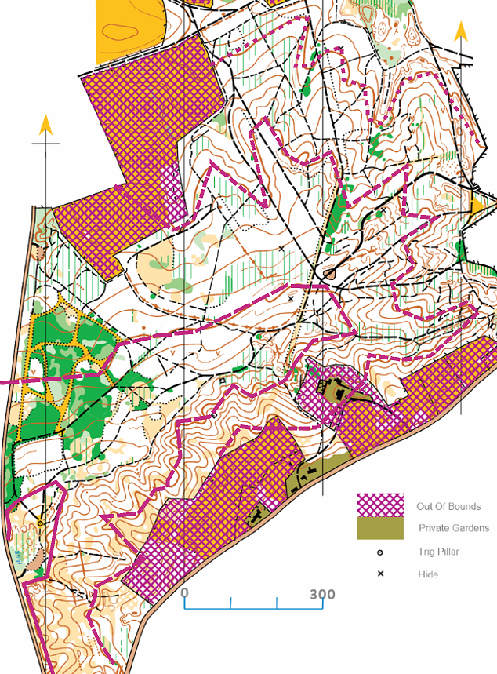
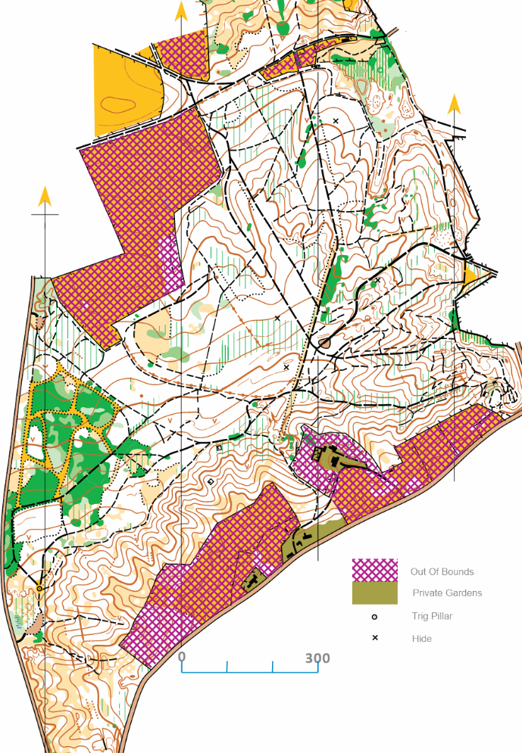
Index contours
Direction of slope

Slide 7
Previous events
Assembly field
S+F
Previous starts are shown
“The start is approximately 500 metres from leaving the assembly field to the east and south and the finish is near the start” i.e. both likely to be in pink area
https://www.walton.routegadget.co.uk/rg2/?#103 2021 WML
https://www.walton.routegadget.co.uk/rg2/?#87 2018 WML
https://www.jk.routegadget.co.uk/rg2/#72
BO Results for the 2021 WML event: https://www.britishorienteering.org.uk/index.php?pg=results&eday=79774
Note also Beaudesert which will be used for JK 2024: https://www.walton.routegadget.co.uk/rg2/#104

Slide 8
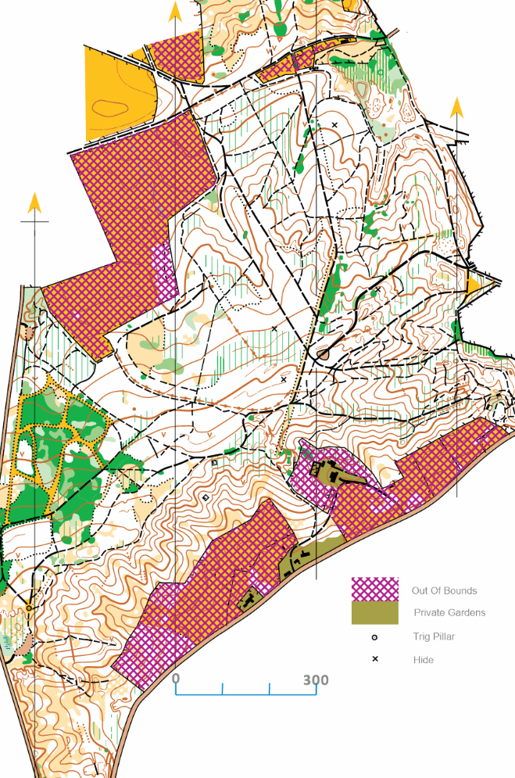
Terrain
B
A
Great visibility. Use the fence/ fence corners for nav/ distance judgement. You can see it from a long way off.
Know where you are coming off the path at the top before heading down the slope! Pause at the top of the hill, check compass, sight ahead, then go.
Steep if you have to go over, sloping generally to SE – very quick and easy running underfoot. Great fun!
Small gullies and pits are mostly on the spurs !?
Clearings are there but not distinct. Use rule of “dead bracken=clearing” in open areas (don’t use as main nav feature, only as a back-up)
Parallel errors possible
For legs across the slope check if an up or a down leg
B
Most brashings in this area. Still good to go straight.
Very open forest. Look up – you can see a long way.
Lots of paths – be careful (maybe extra MTB ones)
Take extra time at the top to check you are going down the correct re-entrant
Slopes to NW, N, NE and E – compass important! They will plan legs to go across the slope (downhill diagonal)
Green = rhodies. Great to navigate from
Use path junctions/ corners as final attackpoint before entering on the compass
Ignore the veg boundaries
X=Hides
A

Slide 9
Terrain
C
Hard/slow to go straight (gorse)
Use the forest rides
Similar to sprint-O, keep on top of next turning
Thickest forest next to the path. Push through 1m then it opens up.
D
‘transfer’ between different areas – more vague
Good visibility – head-up and sight ahead.
Compass is main skill needed here. Straight is the fastest. Watch out for drifting when heading diagonally.
A little undergrowth but should be low this time of year.
Leg lines will likely cross over here – BE CAREFUL
Pits are tiny/ mapped in the wrong place… (in PTB experience). They will use them. Ensure a good attackpoint (path junc./ bend) and meerkat constantly.
D
C

Slide 10
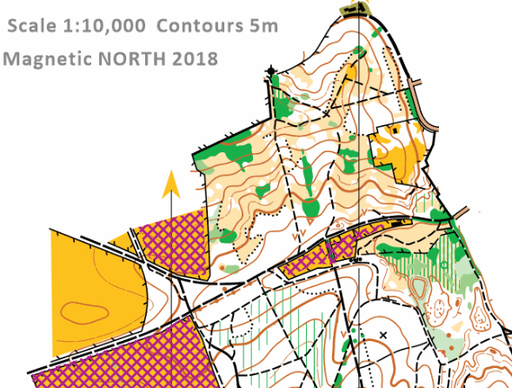
Area to the N
This area might also be woth looking at although it wasn’t used in the last 2 events there (it was used at the JK Middles for the longest courses). [when I plan, I try and use areas that haven’t been used for a while and courses are longer than previous, so let’s see]
Terrain slopes to the N and is fairly open – very visible and quick.
No reason not to go straight. Copses/gorse (green) are very obvious.
Note the Tower which might be visible in the open area.
[for map-spec buffs] note the non-aligned-to-N prominent landform feature (triangular shaped - potentially has been copy and pasted from an old BO platform symbol)

Slide 11
Final Details - Terrain
https://www.walton-chasers.co.uk/wp-content/uploads/2024/01/CSC-Feb-2024-Final-Details.pdf
“Mainly runnable [broad-leaved, deciduous] wood, but with undergrowth, brambles and brashings in some parts.”
“Southern area includes well contoured series of spurs and re-entrants.”
“Be aware that there are many bike tracks in the area that are liable to change so may not have been mapped.”
Streetview
https://www.google.com/maps/place/Chetwynd's+Coppice/@52.7408515,-1.9367134,1555m/data=!3m1!1e3!4m6!3m5!1s0x487a0bbab3b0b67f:0xa8ade78011f8a3b8!8m2!3d52.741207!4d-1.9357858!16s%2Fg%2F1tflfs1t?entry=ttu

Slide 12
Final Details - Courses
Courses
500m to Start and Finish is near the start so likely uphill early on course and downhill at end
Courses 1 and 2 are longer (9.9km/450m, 8.8km/380m) than the Brown (7.3km/260m) at the 2021 WML event so I suspect courses might be a bit tougher than you are used to especially if running up (although the latter event was held in November 21 so as we are in Feb there should be less undergrowth). Anyway, if your course distance (and/or height climb) looks a bit tough then take it easy for the first few (uphill?) controls and make sure of your navigation.
All Compass Sport Cup and Trophy competition course maps (and LG) are in two parts so turn over the map once you finish part one. i.e. even those who usually run Green and Short Green will have a map flip! I don’t know if new IOF CD for map flip (15.6) or ISOM “continuation point after map exchange” (715) will be used, but you may as well be aware of them (see following slides).
NB: make sure you check on the day for on-the-day Final Details as these can vary from those issued in advance of an event (which is why I prefer the term Event Details that are issued beforehand – about 4 years ago I did 2 events where there were v8 of Final Details and I had only printed off v5 so I missed important information).

Slide 13
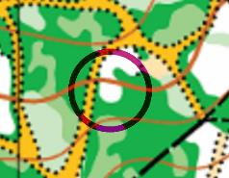
2024 IOF Control Descriptions
Major changes
Now explicitly covers both ISOM and ISSprOM
Description Sheet should be printed in black
If the clarification symbol in column C is not sufficient to unambiguously define the placement of the control flag then the feature is not suitable for a control site
Use of Copse (4.8) symbol extended to include a more runnable area of trees surrounded by thicker forest
Use of Building symbol (5.11) extended to include a pillar supporting a roof
New symbol (5.24) added for a Railway or tramway
Use of Top (12.10) and Beneath (12.13) symbols extended to include the Upper or Lower of two levels
New symbol (15.6) added for a map flip (turn the map over)

Slide 14
ISOM 2017, 2024 revision
To go with the new map flip CD there is also a new symbol for the start after a map exchange.
NB: I don’t know if they’ll be using it or not, but the latest Condes supports it (and the new CD) so you should be aware of it so it doesn’t confuse you if used.

Slide 15
Rules/Scoring 1
Rules were updated in January 2024:
https://pgorienteering.uk/uploads/1/3/9/8/139814617/cscrules_2024_v2.pdf
“The courses must only be identified by course number on the map, on the control descriptions and in the start lanes.
The onus is on Club Captains to advise their team members the number of which course they are to run as they may not be running their normal colour course.”
So make sure you know your COURSE NUMBER!

Slide 16
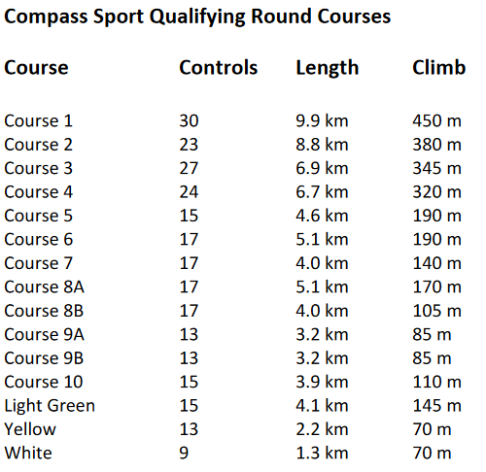
Rules/Scoring 2
Scoring is POINTS so beating someone by 1 place will means MDOC could get more points AND the other person’s club could get less (note: 1 pt per place for Large [1-7]classes and 2 pts per place for Small classes [8A-10]).
If you miss early on or are having a bad run then put it behind you and push on, you may still end up being a scorer for MDOC, or if not, your non-counting result may still push other club’s scorers down by some points.
Note: I say “could” above since there are other rules about how scores are selected/combined for overall MDOC result
Large
Small
Not Scoring

